Slide 1
Software Engineering
UNIT-I
B.Tech-IV SEM
Dept of CSE

Slide 2
What is Software Engineering?
Software is a program or set of programs containing instructions which provide desired functionality. Engineering is the processes of designing and building something that serves a particular purpose and find a cost effective solution to problems.
Software is: (1) instructions (computer programs) that when executed provide desired features, function, and performance; (2) data structures that enable the programs to effectively manipulate information, and (3) descriptive information in both hard copy and virtual forms that describes the operation and use of the programs.
Software Engineering is a systematic approach to the design, development, operation, and maintenance of a software system.
Dept of CSE

Slide 3
Why is Software Engineering required?
Software Engineering is required due to the following reasons:
  To manage Large software
  For more Scalability
  Cost Management
  To manage the dynamic nature of software
  For better quality Management
Dept of CSE

Slide 4
Need of Software Engineering
The necessity of software engineering appears because of a higher rate of progress in user requirements and the environment on which the program is working.
Huge Programming: It is simpler to manufacture a wall than to a house or building, similarly, as the measure of programming become extensive engineering has to step to give it a scientific process.
Adaptability: If the software procedure were not based on scientific and engineering ideas, it would be simpler to re-create new software than to scale an existing one.
Dept of CSE

Slide 5
Cost: As the hardware industry has demonstrated its skills and huge manufacturing has let down the cost of computer and electronic hardware. But the cost of programming remains high if the proper process is not adapted.
Dynamic Nature: The continually growing and adapting nature of programming hugely depends upon the environment in which the client works. If the quality of the software is continually changing, new upgrades need to be done in the existing one.
Quality Management: Better procedure of software development provides a better and quality software product.
Dept of CSE

Slide 6
Objectives of Software Engineering:
Maintainability –
It should be feasible for the software to evolve to meet changing requirements.
Efficiency –
The software should not make wasteful use of computing devices such as memory ,processor cycles etc..
Correctness –
A software product is correct, if the different requirements as specified in the SRS document have been correctly implemented.
Adaptability –
In this case, software allows differing system constraints and user needs to be satisfied by making changes to the software.
Dept of CSE

Slide 7
Reusability –
A software product has good reusability, if the different modules of the product can easily be reused to develop new products.
Testability –
Here software facilitates both the establishment of test criteria and the evaluation of the software with respect to those criteria.
Reliability –
It is an attribute of software quality. The extent to which a program can be expected to perform its desired function, over an arbitrary time period.
Portability –
In this case, software can be transferred from one computer system or environment to another.
Dept of CSE

Slide 8
Interoperability – Capability of 2 or more functional units to process data cooperatively.
Dept of CSE

Slide 9
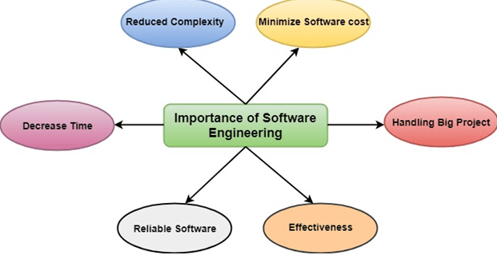
Importance of Software Engineering
Dept of CSE

Slide 10
Software Processes
A software process is the set of activities and associated outcome that produce a software product.
Software engineers mostly carry out these activities. These are FIVE key process framework activities, which are common to all software processes.
Communication. Before any technical work can commence, it is critically important to communicate and collaborate with the customer (and others takeholders The intent is to understand stakeholders’ objectives for the project and to gather requirements that help define software features and functions.
Dept of CSE

Slide 11
Planning. Any complicated journey can be simplified if a map exists. A software project is a complicated journey, and the planning activity creates a “map” that helps guide the team as it makes the journey. The map—called a software project plan.
Modeling. Whether you’re a landscaper, a bridge builder, an aeronautical engineer, a carpenter, or an architect, you work with models every day. You create a “sketch” of the thing so that you’ll understand the big picture—what it will look like architecturally, how the constituent parts fit together, and many other characteristics. If required, you refine the sketch into greater and greater detail in an effort to better understand the problem and how you’re going to solve it. A software engineer does the same thing by creating models to better understand software requirements and the design that will achieve those requirements.
Dept of CSE

Slide 12
Construction. This activity combines code generation (either manual or automated) and the testing that is required to uncover errors in the code.
Deployment. The software is delivered to the customer who evaluates the delivered product and provides feedback based on the evaluation.
Dept of CSE

Slide 13
Software engineering process framework activities are complemented by a number of umbrella activities.
In general, umbrella activities are applied throughout a software project and help a software team manage and control progress, quality, change, and risk.
Typical umbrella activities include:
Software project tracking and control—allows the software team to assess progress against the project plan and take any necessary action to maintain the schedule.
Risk management— assesses risks that may affect the outcome of the project or the quality of the product.
Software quality assurance— defines and conducts the activities required to ensure software quality.
Dept of CSE

Slide 14
Technical reviews— assesses software engineering work products in an effort to uncover and remove errors before they are propagated to the next activity.
Measurement— defines and collects process, project, and product measures that assist the team in delivering software that meets stakeholders’ needs.
Software configuration management— manages the effects of change throughout the software process.
Reusability management— defines criteria for work product reuse (including software components) and establishes mechanisms to achieve reusable components.
Work product preparation and production— encompasses the activities required to create work products such as models, documents, logs, forms, and lists.
Dept of CSE

Slide 15
Software Engineering Practice
Software Engineering is concerned with developing and maintaining software systems that behave reliably and efficiently, are affordable to develop and maintain, and satisfy all the requirements that customers have defined them.
Development Requires analysis and synthesis.
  Analysis: Decompose a large problem into smaller, understandable pieces
  Synthesis: Build software from smaller building blocks.
Dept of CSE

Slide 16
Software Engineering Practice
Consists of a collection of concepts, principle,, methods, and tools that a software engineer calls upon a daily basis.
Equips managers to manage software projects and software engineers to build computer programs
Provides necessary technical and management how to getting the job done.
Dept of CSE

Slide 17
Nature of Practice
Understand the problem(Communication and analysis)
Plan a solution(Planning, modeling and software design)
Carryout plan(construction, code generation)
Examine the results for accuracy(testing and quality assurance)
Dept of CSE

Slide 18
Nature of software
S/W is developed or engineered , it is not manufactures
Software doesn’t “wear out.”
Although the industry is moving toward component-based construction, most software continues to be custom built.
S/W is complex and expensive
S/W is risky(future is uncertain)
Component based construction. (different parts of s/w will integrated later.)
Saturation point(No further upgrade)
In software no new features are added only upgraded.
Dept of CSE

Slide 19
S/W is developed or engineered , it is not manufactures
Although some similarities exist between software development and hardware manufacturing, the two activities are fundamentally different.
In both activities, high quality is achieved through good design, but the manufacturing phase for hardware can introduce quality problems that are nonexistent for software. Both activities are dependent on people, but the relationship between people applied and work accomplished is entirely different.
Software costs are concentrated in engineering. This means that software projects cannot be managed as if they were manufacturing projects.
Dept of CSE

Slide 20
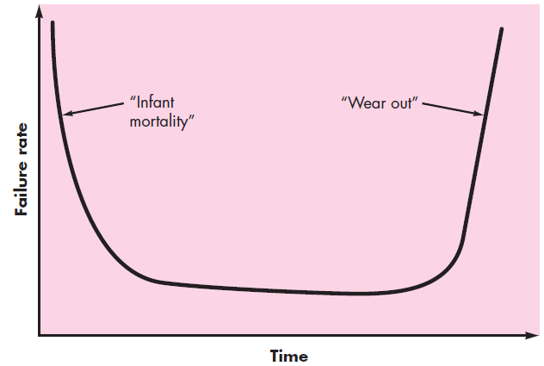
Software doesn’t “wear out.”
Dept of CSE

Slide 21
Figure above depicts failure rate as a function of time for hardware. The relationship, often called the “bathtub curve,” indicates that hardware exhibits relatively high failure rates early in its life.
defects are corrected and the failure rate drops to a steady-state level (hopefully, quite low) for some period of time. As time passes, however, the failure rate rises again as hardware components suffer from the cumulative effects of dust, vibration, abuse, temperature extremes, and many other environmental maladies. Stated simply, the hardware begins to wear out.
Software is not susceptible to the environmental maladies that cause hardware to wear out.
Dept of CSE

Slide 22
In theory, therefore, the failure rate curve for software should take the form of the “idealized curve” shown in Figure below
Undiscovered defects will cause high failure rates early in the life of a program. However, these are corrected and the curve flattens as shown. The idealized curve is a gross oversimplification of actual failure models for software.
However, the implication is clear—software doesn’t wear out. But it does deteriorate!
During its life,software will undergo change. As changes are made, it is likely that errors will be introduced, causing the failure rate curve to spike as shown in the “actual curve”
Dept of CSE

Slide 23
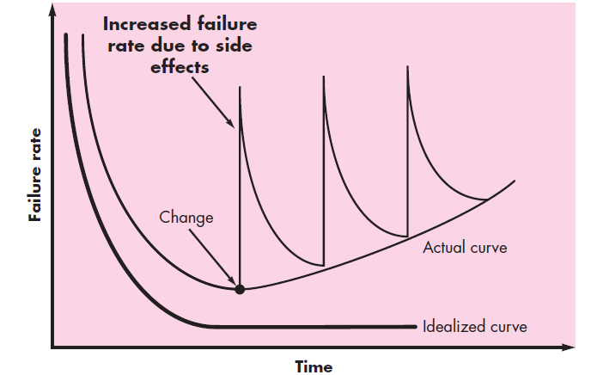
Dept of CSE

Slide 24
Although the industry is moving toward component-based construction, most software continues to be custom built.
only two of thousands of standard components that are used by mechanical and electrical engineers as they design new systems.
The reusable components have been created so that the engineer can concentrate on the truly innovative elements of a design.
In the hardware world, component reuse is a natural part of the engineering process.
Dept of CSE

Slide 25
A software component should be designed and implemented so that it can be reused in many different programs.
Modern reusable components encapsulate both data and the processing that is applied to the data, enabling the software engineer to create new applications from reusable parts.
For example, today’s interactive user interfaces are built with reusable components that enable the creation of graphics windows, pull-down menus, and a wide variety of interaction mechanisms
Dept of CSE

Slide 26
Software Application Domains
The Seven broad categories of software are challenges for software engineers:
  System software
  Application software
  Engineering & scientific software
  Embedded software
  Product – line software
  Web Applications
  Artificial Intelligence software
Dept of CSE

Slide 27
Legacy Software
Hundreds of thousands of computer programs fall into one of the seven broad application domains discussed in the preceding subsection.
Some of these are just released to individuals, industry, and government. But other programs are older, in some cases much older.
These older programs—often referred to as legacy software.
Legacy software systems . . . were developed decades ago and have been continually modified to meet changes in business requirements and computing platforms. The proliferation of such systems is causing headaches for large organizations who find them costly to maintain and risky to evolve.
Dept of CSE

Slide 28
Unfortunately, there is sometimes one additional characteristic that is present in legacy software—poor quality.
Legacy systems sometimes have inextensible designs, convoluted code, poor or nonexistent documentation, test cases and results that were never archived, a poorly managed change history etc..
What to do? The only reasonable answer may be: Do nothing, at least until the legacy system must undergo some significant changes for the following reasons.
• The software must be adapted to meet the needs of new computing environments or technology.
• The software must be enhanced to implement new business requirements.
Dept of CSE

Slide 29
• The software must be extended to make it interoperable with other more modern systems or databases.
• The software must be re-architected to make it viable within a network environment.
Dept of CSE

Slide 30
SOFTWARE ENGINEERING
In order to build software that is ready to meet the challenges of the twenty-first century, you must recognize a few simple realities:
It follows that a concerted effort should be made to understand the problem before a software solution is developed.
It follows that design becomes a pivotal(Crucial) activity.
It follows that software should exhibit high quality.
It follows that software should be maintainable.
Software Engineering: The application of a systematic, disciplined, quantifiable approach to the development, operation, and maintenance of software; that is, the application of engineering to software.
Dept of CSE

Slide 31
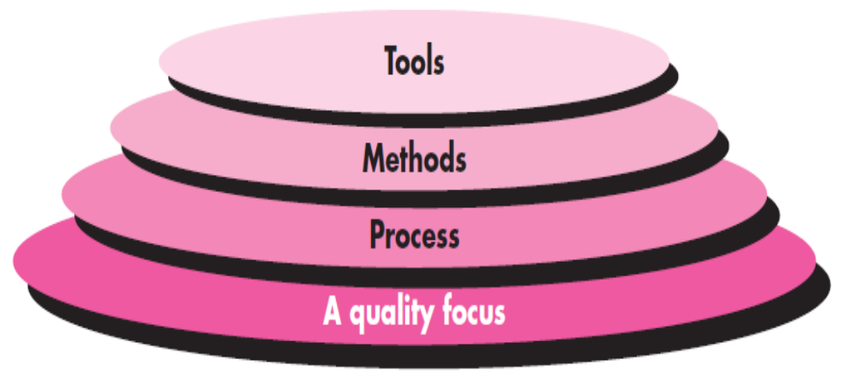
Software engineering is a layered technology.
SoftwareEngineering Layers
Dept of CSE

Slide 32
The bedrock that supports software engineering is a quality focus.
any engineering approach (including software engineering) must rest on an organizational commitment to quality.
Total quality management, Six Sigma, and similar philosophies foster a continuous process improvement culture, and it is this culture that ultimately leads to the development of increasingly more effective approaches to software engineering.
The foundation for software engineering is the process layer.
Process defines a framework that must be established for effective delivery of software engineering technology.
The software process forms the basis for management control of software projects and establishes the context in which technical methods are applied, work products (models, documents, data, reports, forms, etc.) are produced, milestones are established, quality is ensured, and change is properly managed.
Dept of CSE

Slide 33
Software engineering methods provide the technical how-to’s for building software.
Methods encompass a broad array of tasks that include communication, requirements analysis, design modeling, program construction, testing, and support.
Software engineering tools provide automated or semiautomated support for the process and the methods.
When tools are integrated so that information created by one tool can be used by another, a system for the support of software development, called computer-aided software engineering, is established.
Dept of CSE

Slide 34
Software Myths
The development of software requires dedication and understanding on the developers’ part. Many software problems arise due to myths that are formed during the initial stages of software development.
Types of Myths
  Management Myths
  Customer Myths
  Practioner’s Myths
Dept of CSE

Slide 35
Software Myths
Management myths: Managers with software responsibility are often under pressure to maintain budgets, keep schedules from slipping, and improve quality.
Following are the management myths:
Myth: We already have a book that’s full of standards and procedures for building software, won’t that provide my people with everything they need to know?
Reality: The book of standards may very well exist, but isn’t used. Most software practitioners aren’t aware of its existence. Also, it doesn’t reflect modern software engineering practices and is also complete.
Dept of CSE

Slide 36
Management Myths
Myth: My people have state-of-the-art software development tools, after all, we buy them the newest computers.
Reality: It takes much more than the latest model mainframe, workstation, or PC to do high-quality software development. Computer-aided software engineering (CASE) tools are more important than hardware for achieving good quality and productivity, yet the majority of software developers still do not use them effectively.
Dept of CSE

Slide 37
Management myths
Myth: If we get behind schedule, we can add more programmers and catch up (sometimes called the Mongolian horde concept).
Reality: Software development is not a mechanistic process like manufacturing. As new people are added, people who were working must spend time educating the newcomers, thereby reducing the amount of time spent on productive development effort. People can be added but only in a planned and well-coordinated manner.
Myth: If I decide to outsource the software project to a third party, I can just relax and let that firm build it.
Reality: If an organization does not understand how to manage and control software projects internally, it will invariably struggle when it outsources software projects.
Dept of CSE

Slide 38
Customer myths
Myth: A general statement of objectives is sufficient to begin writing programs-we can fill in the details later.
Reality: A poor up-front definition is the major cause of failed software efforts. A formal and detailed description of the functions, behavior, performance, interfaces, design constraints, and validation criteria is essential.
Dept of CSE

Slide 39
Customer myths
Myth: Project requirements continually change, but change can be easily accommodated because software is flexible.
Reality: It is true that software requirements change, but the impact of change varies with the time at which it is introduced. When changes are requested during software design, the cost impact grows rapidly. Resources have been committed and a design framework has been established. Change can cause heavy additional costs. Change, when requested after software is in production, can be much more expensive than the same change requested earlier.
Dept of CSE

Slide 40
Practitioner’s myths
Myth: Once we write the program and get it to work, our job is done.
Reality: Industry data indicate that between 60 and 80 percent of all effort expended on software will be expended after it is delivered to the customer for the first time.
Myth: Until I get the program “running” I have no way of assessing its quality.
Reality: One of the most effective software quality assurance mechanisms can be applied from the inception of a project—the formal technical review.
Dept of CSE

Slide 41
SDLC (Software Development Life Cycle)
SDLC is a systematic process for building software that ensures the quality and correctness of the software built.
SDLC process aims to produce high-quality software that meets customer expectations.
The system development should be complete in the pre-defined time frame and cost.
SDLC consists of a detailed plan which explains how to plan, build, and maintain specific software.
Every phase of the SDLC life Cycle has its own process and deliverables that feed into the next phase.
Dept of CSE

Slide 42
SDLC Phases
The entire SDLC process divided into the following SDLC steps:
  Phase 1: Requirement collection and analysis
  Phase 2: Feasibility study
  Phase 3: Design
  Phase 4: Coding
  Phase 5: Testing
  Phase 6: Installation/Deployment
  Phase 7: Maintenance
Dept of CSE

Slide 43
Phase 1: Requirement collection and analysis
The requirement is the first stage in the SDLC process. It is conducted by the senior team members with inputs from all the stakeholders and domain experts in the industry. Planning for the quality assurance requirements and recognization of the risks involved is also done at this stage.
This stage gives a clearer picture of the scope of the entire project and the anticipated issues, opportunities, and directives which triggered the project.
Requirements Gathering stage need teams to get detailed and precise requirements. This helps companies to finalize the necessary timeline to finish the work of that system.
Dept of CSE

Slide 44
Phase 2: Feasibility study
Once the requirement analysis phase is completed the next sdlc step is to define and document software needs. This process conducted with the help of ‘Software Requirement Specification’ document also known as ‘SRS’ document. It includes everything which should be designed and developed during the project life cycle.
There are mainly five types of feasibilities checks:
Economic: Can we complete the project within the budget or not?
Legal: Can we handle this project as cyber law and other regulatory framework/compliances.
Operation feasibility: Can we create operations which is expected by the client?
Technical: Need to check whether the current computer system can support the software
Schedule: Decide that the project can be completed within the given schedule or not.
Dept of CSE

Slide 45
Phase 3: Design
In this third phase, the system and software design documents are prepared as per the requirement specification document. This helps define overall system architecture.
This design phase serves as input for the next phase of the model.
There are two kinds of design documents developed in this phase:
High-Level Design (HLD)
Brief description and name of each module
An outline about the functionality of every module
Interface relationship and dependencies between modules
Database tables identified along with their key elements
Complete architecture diagrams along with technology details
Low-Level Design (LLD)
Functional logic of the modules
Database tables, which include type and size
Complete detail of the interface
Addresses all types of dependency issues
Listing of error messages
Complete input and outputs for every module
Dept of CSE

Slide 46
Phase 4: Coding
Once the system design phase is over, the next phase is coding. In this phase, developers start build the entire system by writing code using the chosen programming language. In the coding phase, tasks are divided into units or modules and assigned to the various developers. It is the longest phase of the Software Development Life Cycle process.
In this phase, Developer needs to follow certain predefined coding guidelines. They also need to use programming tools like compiler, interpreters, debugger to generate and implement the code.
Dept of CSE

Slide 47
Phase 5: Testing
Once the software is complete, and it is deployed in the testing environment. The testing team starts testing the functionality of the entire system. This is done to verify that the entire application works according to the customer requirement.
During this phase, QA and testing team may find some bugs/defects which they communicate to developers. The development team fixes the bug and send back to QA for a re-test. This process continues until the software is bug-free, stable, and working according to the business needs of that system.
Dept of CSE

Slide 48
Phase 6: Installation/Deployment
Once the software testing phase is over and no bugs or errors left in the system then the final deployment process starts. Based on the feedback given by the project manager, the final software is released and checked for deployment issues if any.
Dept of CSE

Slide 49
Phase 7: Maintenance
Once the system is deployed, and customers start using the developed system, following 3 activities occur
Bug fixing – bugs are reported because of some scenarios which are not tested at all
Upgrade – Upgrading the application to the newer versions of the Software
Enhancement – Adding some new features into the existing software
Dept of CSE

Slide 50
Waterfall model
The waterfall model is a classical development process model proposed by R. W. Royce in 1970.
In this model, software development proceeds through an orderly sequence of transitions from one phase to the next in order (like a waterfall).
In a waterfall model, each phase must be completed before the next phase can begin and there is no overlapping in the phases.
The waterfall Model illustrates the software development process in a linear sequential flow.
In Waterfall model, the outcome of one phase acts as the input for the next phase sequentially.
Dept of CSE

Slide 51
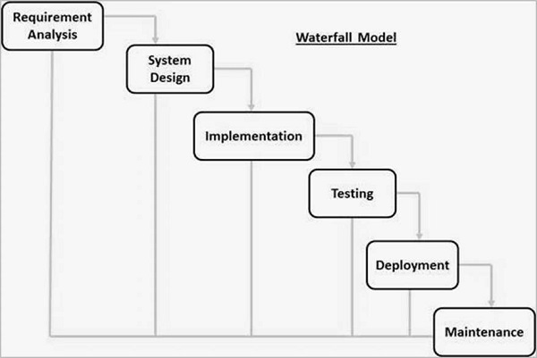
Dept of CSE

Slide 52
Requirement Gathering and analysis − All possible requirements of the system to be developed are captured in this phase and documented in a requirement specification document.
System Design − The requirement specifications from first phase are studied in this phase and the system design is prepared. This system design helps in specifying hardware and system requirements and helps in defining the overall system architecture.
Implementation − With inputs from the system design, the system is first developed in small programs called units, which are integrated in the next phase. Each unit is developed and tested for its functionality, which is referred to as Unit Testing.
Dept of CSE

Slide 53
Integration and Testing − All the units developed in the implementation phase are integrated into a system after testing of each unit. Post integration the entire system is tested for any faults and failures.
Deployment of system − Once the functional and non-functional testing is done; the product is deployed in the customer environment or released into the market.
Maintenance − There are some issues which come up in the client environment. To fix those issues, patches are released. Also to enhance the product some better versions are released. Maintenance is done to deliver these changes in the customer environment.
Dept of CSE

Slide 54
Waterfall Model - Application
Every software developed is different and requires a suitable SDLC approach to be followed based on the internal and external factors. Some situations where the use of Waterfall model is most appropriate are −
Requirements are very well documented, clear and fixed.
Product definition is stable.
Technology is understood and is not dynamic.
There are no ambiguous requirements.
Ample resources with required expertise are available to support the product.
The project is short.
Dept of CSE

Slide 55
Waterfall Model - Advantages
Simple and easy to understand and use
Easy to manage due to the rigidity of the model. Each phase has specific deliverables and a review process.
Phases are processed and completed one at a time.
Works well for smaller projects where requirements are very well understood.
Clearly defined stages.
Well understood milestones.
Easy to arrange tasks.
Process and results are well documented.
Dept of CSE

Slide 56
Waterfall Model - Disadvantages
No working software is produced until late during the life cycle.
High amounts of risk and uncertainty.
Not a good model for complex and object-oriented projects.
Poor model for long and ongoing projects.
Not suitable for the projects where requirements are at a moderate to high risk of changing. So, risk and uncertainty is high with this process model.
It is difficult to measure progress within stages.
Cannot accommodate changing requirements.
Adjusting scope during the life cycle can end a project.
Integration is done as a "big-bang. at the very end, which doesn't allow identifying any technological or business bottleneck or challenges early.
Dept of CSE

Slide 57
Prototype Model
Prototyping Model is a software development model in which prototype is built, tested, and reworked until an acceptable prototype is achieved.
It also creates base to produce the final system or software.
It works best in scenarios where the project’s requirements are not known in detail.
It is an iterative, trial and error method which takes place between developer and client.
Dept of CSE

Slide 58
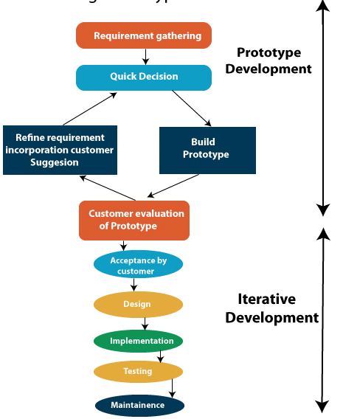
Dept of CSE

Slide 59
Step 1: Requirements gathering
A prototyping model starts with requirement analysis. In this phase, the requirements of the system are defined in detail. During the process, the users of the system are interviewed to know what is their expectation from the system.
Step 2: Quick design
The second phase is a preliminary design or a quick design. In this stage, a simple design of the system is created. However, it is not a complete design. It gives a brief idea of the system to the user. The quick design helps in developing the prototype.
Dept of CSE

Slide 60
Step 3: Build a Prototype
In this phase, an actual prototype is designed based on the information gathered from quick design. It is a small working model of the required system.
Step 4: customer evaluation
In this stage, the proposed system is presented to the client for an initial evaluation. It helps to find out the strength and weakness of the working model. Comment and suggestion are collected from the customer and provided to the developer.
Dept of CSE

Slide 61
Step 5: Refining Requirement
If the user is not happy with the current prototype, you need to refine the prototype according to the user’s feedback and suggestions.
This phase will not over until all the requirements specified by the user are met. Once the user is satisfied with the developed prototype, a final system is developed based on the approved final prototype.
Step 6: Implement Product and Maintain
Once the final system is developed based on the final prototype, it is thoroughly tested and deployed to production. The system undergoes routine maintenance for minimizing downtime and prevent large-scale failures.
Dept of CSE

Slide 62
When to use Prototype model:
Prototype model should be used when the desired system needs to have a lot of interaction with the end users.
Typically, online systems, web interfaces have a very high amount of interaction with end users, are best suited for Prototype model. It might take a while for a system to be built that allows ease of use and needs minimal training for the end user.
Prototyping ensures that the end users constantly work with the system and provide a feedback which is incorporated in the prototype to result in a useable system. They are excellent for designing good human computer interface systems.
Dept of CSE

Slide 63
Prototyping is an attractive idea for complicated and large systems for which there is no manual process or existing system to help determine the requirements.
prototyping is well suited for projects where requirements are hard to determine and the confidence in the stated requirements is low
Dept of CSE

Slide 64
Advantage of Prototype Model
Reduce the risk of incorrect user requirement
Good where requirement are changing/uncommitted
as requirements will be more stable now due to the feedback from the prototype, there will be fewer changes in the requirements. Consequently the costs incurred due to changes in the requirements will be substantially reduced.
the experience of developing the prototype will reduce the cost of the actual software development. But extra cost for prototype is considerable.
the quality of final software is likely to be far superior,
Support early product marketing
Reduce Maintenance cost.
Dept of CSE

Slide 65
Errors can be detected much earlier as the system is made side by side.
It is also an excellent technique for reducing some types of risks associated with a project.
Dept of CSE

Slide 66
Disadvantage of Prototype Model
An unstable/badly implemented prototype often becomes the final product.
Require extensive customer collaboration
  Costs customer money
  Needs committed customer
  Difficult to finish if customer withdraw
  May be too customer specific, no broad market
Difficult to know how long the project will last.
Easy to fall back into the code and fix without proper requirement analysis, design, customer evaluation, and feedback.
Prototyping tools are expensive.
Special tools & techniques are required to build a prototype.
It is a time-consuming process.
Dept of CSE

Slide 67
Iterative Model
In the Iterative model, iterative process starts with a simple implementation of a small set of the software requirements and iteratively enhances the evolving versions until the complete system is implemented and ready to be deployed.
Here , we start with some of the software specifications and develop the first version of the software. After the first version if there is a need to change the software, then a new version of the software is created with a new iteration. Every release of the Iterative Model finishes in an exact and fixed period that is called iteration.
The Iterative Model allows the accessing earlier phases, in which the variations made respectively. The final output of the project updated at the end of the Software Development Life Cycle (SDLC) process.
Dept of CSE

Slide 68
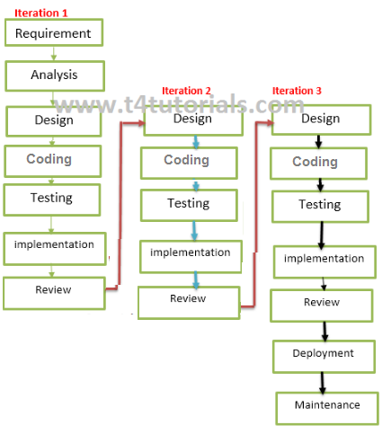

Dept of CSE

Slide 69
The key to a successful use of an iterative software development lifecycle is rigorous validation of requirements, and verification & testing of each version of the software against those requirements within each cycle of the model.
Dept of CSE

Slide 70
Phases of Iterative model
1. Requirement gathering & analysis: In this phase, requirements are gathered from customers and check by an analyst whether requirements will fulfil or not. Analyst checks that need will achieve within budget or not. After all of this, the software team skips to the next phase.
2. Design: In the design phase, team design the software by the different diagrams like Data Flow diagram, activity diagram, class diagram, state transition diagram, etc.
3. Implementation: In the implementation, requirements are written in the coding language and transformed into computer programmes which are called Software.
Dept of CSE

Slide 71
4. Testing: After completing the coding phase, software testing starts using different test methods. There are many test methods, but the most common are white box, black box, and grey box test methods.
5. Deployment: After completing all the phases, software is deployed to its work environment.
6. Review: In this phase, after the product deployment, review phase is performed to check the behaviour and validity of the developed product. And if there are any error found then the process starts again from the requirement gathering.
7. Maintenance: In the maintenance phase, after deployment of the software in the working environment there may be some bugs, some errors or new updates are required. Maintenance involves debugging and new addition options.
Dept of CSE

Slide 72
When to use
When requirements are defined clearly and easy to understand.
When the software application is large.
When there is a requirement of changes in future.
When there is a need for more quality in software.
New technology is being used
Dept of CSE

Slide 73
Advantage(Pros) of Iterative Model:
We can start with a little of a requirement specification.
Testing and debugging during smaller iteration is easy.
It is easily acceptable to ever-changing needs of the project.
Risks are identified and resolved during iteration.
Limited time spent on documentation and extra time on designing.
Less time is utilized for documentation.
More time is utilized for software development.
Dept of CSE

Slide 74
Disadvantage(Cons) of Iterative Model:
It is not suitable for smaller projects.
More Resources may be required.
Design can be changed again and again because of imperfect requirements.
Requirement changes can cause over budget.
Project completion date not confirmed because of changing requirements.
Dept of CSE

Slide 75
Incremental Model:
Incremental Model is a process of software development where requirements divided into multiple standalone modules of the software development cycle.
In this model, each module goes through the requirements, design, implementation and testing phases.
Every subsequent release of the module adds function to the previous release. The process continues until the complete system achieved.
Dept of CSE

Slide 76
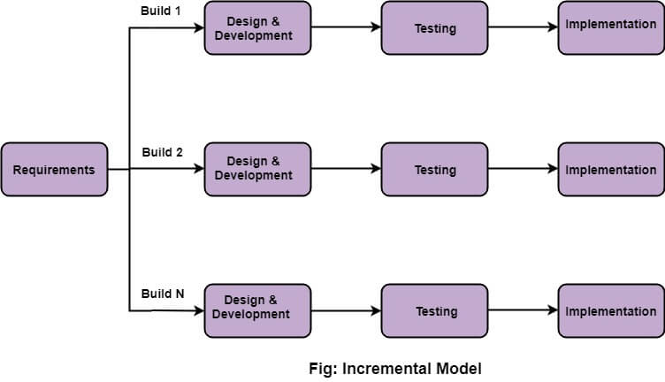
Dept of CSE

Slide 77
The various phases of incremental model are as follows:
1. Requirement analysis: In the first phase of the incremental model, the product analysis expertise identifies the requirements. And the system functional requirements are understood by the requirement analysis team. To develop the software under the incremental model, this phase performs a crucial role.
2. Design & Development: In this phase of the Incremental model of SDLC, the design of the system functionality and the development method are finished with success. When software develops new practicality, the incremental model uses style and development phase.
3. Testing: In the incremental model, the testing phase checks the performance of each existing function as well as additional functionality. In the testing phase, the various methods are used to test the behavior of each task.
Dept of CSE

Slide 78
4. Implementation: Implementation phase enables the coding phase of the development system. It involves the final coding that design in the designing and development phase and tests the functionality in the testing phase. After completion of this phase, the number of the product working is enhanced and upgraded up to the final system product
When we use the Incremental Model?
When the requirements are superior.
A project has a lengthy development schedule.
When Software team are not very well skilled or trained.
When the customer demands a quick release of the product.
You can develop prioritized requirements first.
Dept of CSE

Slide 79
Advantage of Incremental Model
Errors are easy to be recognized.
Easier to test and debug
More flexible.
Simple to manage risk because it handled during its iteration.
The Client gets important functionality early.
Disadvantage of Incremental Model
Need for good planning
Total Cost is high.
Well defined module interfaces are needed.
Dept of CSE

Slide 80
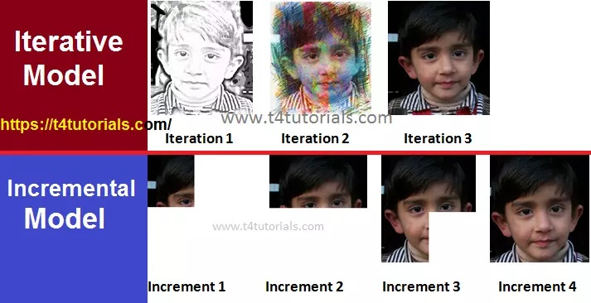
Dept of CSE

Slide 81
Unified Process
During the early 1990s James Rumbaugh, Grady Booch , and Ivar Jacobson began working on a “unified method” that would combine the best features of each of their individual object-oriented analysis and design methods and adopt additional features proposed by other experts in object-oriented modeling.
The result was UML—a unified modeling language that contains a robust notation for the modeling and development of object-oriented systems. By 1997, UML became a de facto industry standard for object-oriented software development.
Dept of CSE

Slide 82
Over the next few years, Jacobson, Rumbaugh,and Booch developed the Unified Process, a framework for object-oriented software engineering using UML. Today, the Unified Process (UP) and UML are widely used on object-oriented projects of all kinds.
Unified process (UP) is an architecture centric, use case driven, iterative and incremental development process.
The Unified Process is an attempt to draw on the best features and characteristics of traditional software process models, but characterize them in a way that implements many of the best principles of agile software development.
The Unified Process emphasizes the important role of software architecture and “helps the architect focus on the right goals, such as understandability, reliance to future changes, and reuse”.
Dept of CSE

Slide 83
Phases of the Unified Process
This process divides the development process into five phases:
Inception
Elaboration
Conception
Transition
Production
Dept of CSE

Slide 84
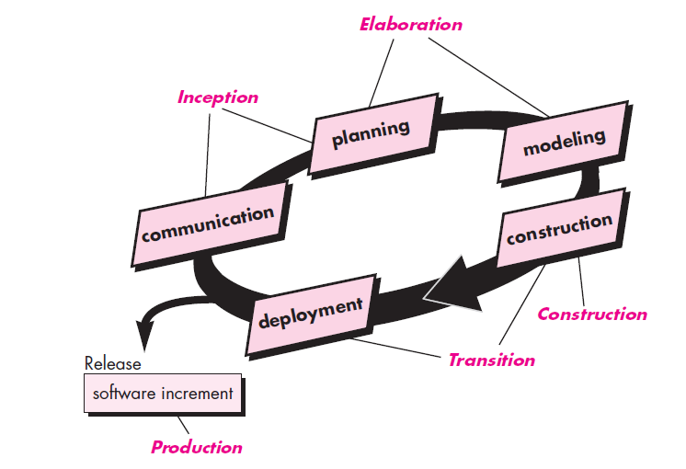
Dept of CSE

Slide 85
INCEPTION
The inception phase of the UP encompasses both customer communication and planning activities. By collaborating with stakeholders, business requirements for the software are identified; a rough architecture for the system is proposed; and a plan for the iterative, incremental nature of the ensuing project is developed.
The inception phase has the following objectives:
  Gathering and analyzing the requirements.
  Planning and preparing a business case and evaluating
  alternatives for risk management, scheduling resources etc.
  Estimating the overall cost and schedule for the project.
  Studying the feasibility and calculating profitability of the project.
Dept of CSE

Slide 86
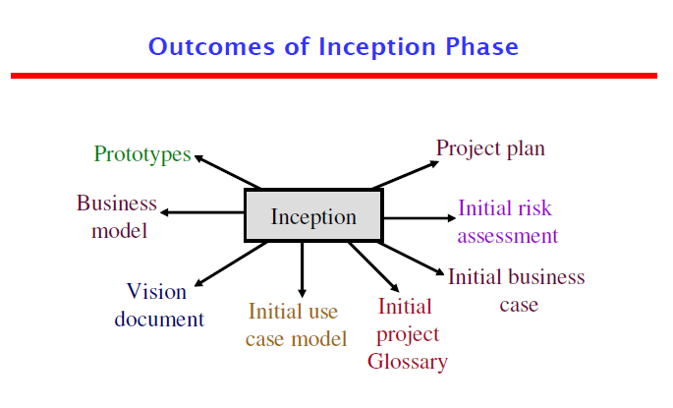
Dept of CSE

Slide 87
Elaboration
The elaboration phase encompasses the planning and modeling activities of the generic process model.
The elaboration phase has the following objectives:
  Establishing architectural foundations.
  Design of use case model.
  Elaborating the process, infrastructure & development environment.
  Selecting component.
  Demonstrating that architecture support the vision at reasonable cost & within specified time.
Dept of CSE

Slide 88
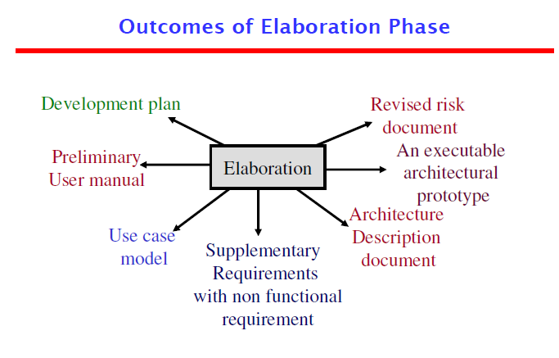
Dept of CSE

Slide 89
CONSTRUCTION PHASE
The construction phase of the UP is identical to the construction activity defined for the generic software process. Using the architectural model as input, the construction phase develops or acquires the software components that will make each use case operational for end users.
The construction phase has the following objectives:
  Implementing the project.
  Minimizing development cost.
  Management and optimizing resources.
  Testing the product
  Assessing the product releases against acceptance criteria
Dept of CSE

Slide 90
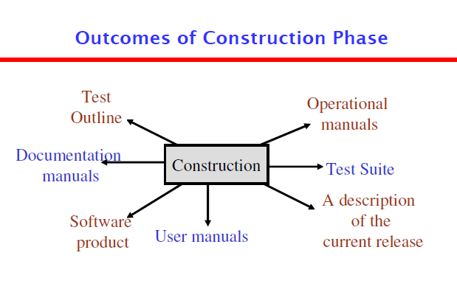
Dept of CSE

Slide 91
TRANSACTION PHASE
The transition phase of the UP encompasses the latter stages of the generic construction activity and the first part of the generic deployment (delivery and feedback) activity.
The transition phase has the following objectives:
  Starting of beta testing
  Analysis of user’s views.
  Training of users.
  Tuning activities including bug fixing and enhancements for performance & usability
  Assessing the customer satisfaction.
Dept of CSE

Slide 92
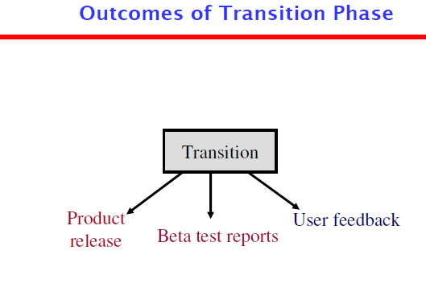
Dept of CSE

Slide 93
PRODUCTION PHASE
The production phase of the UP coincides with the deployment activity of the generic process. During this phase, the ongoing use of the software is monitored, support for the operating environment (infrastructure) is provided, and defect reports and requests for changes are submitted and evaluated.
Dept of CSE

Slide 94
Advantages
It allows us to deal with changing requirements within the project’s development life cycle as per the client or customer needs, i.e. it welcomes change.
It supports incremental build the software product.
It provides proper documentation of the software product.
It helps to use the resources efficiently.
It helps to identify issues early in the process life cycle.
It improves process control and risk management.
It enhances team productivity.
It helps reduces unexpected development costs.
Dept of CSE

Slide 95
Disadvantages
It is a complex model to implement as it has multiple stages of the workflow.
It is challenging for organizations to implement which has, small team size or projects.
It should be highly result-oriented from individuals or teams.
It emphasizes the integration of modules throughout the software development process, so this creates trouble during the testing phase.
Dept of CSE

Slide 96
RAD Model
The Rapid Application Development Model was first proposed by IBM in the 1980s.
The critical feature of this model is the use of powerful development tools and techniques. A software project can be implemented using this model if the project can be broken down into small modules wherein each module can be assigned independently to separate teams.
Rapid Application Development model is a software development process based on prototyping without any specific planning.
In RAD model, there is less attention paid to the planning and more priority is given to the development tasks.
It targets at developing software in a short span of time. the time frame for delivery(time-box) is generally 60-90 days.
Dept of CSE

Slide 97
RAD (Rapid Application Development) is a concept that products can be developed faster and of higher quality through:
  Gathering requirements using workshops or focus groups
  Prototyping and early, reiterative user testing of designs
  The re-use of software components
  A rigidly paced schedule that refers design improvements to the next product version
  Less formality in reviews and other team communication
Dept of CSE

Slide 98
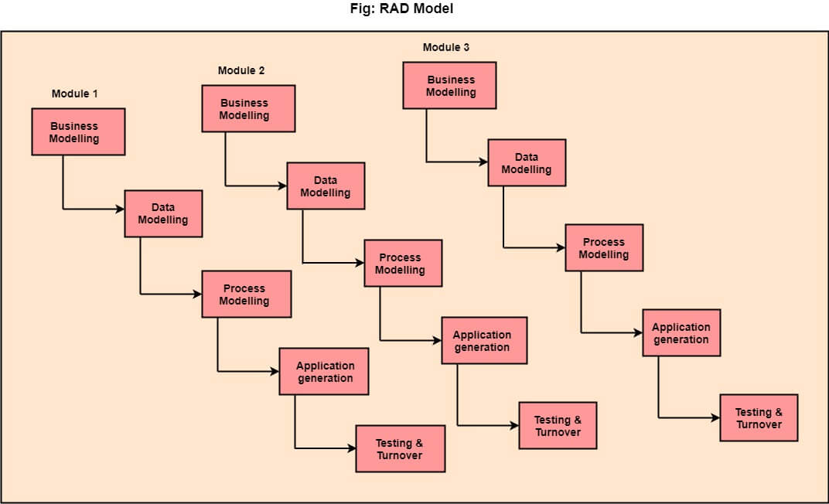
Dept of CSE

Slide 99
The various phases of RAD are as follows:
1.Business Modelling: The information flow among business functions is defined by answering questions like what data drives the business process, what data is generated, who generates it, where does the information go, who process it and so on.
2. Data Modelling: The data collected from business modeling is refined into a set of data objects (entities) that are needed to support the business. The attributes (character of each entity) are identified, and the relation between these data objects (entities) is defined.
3. Process Modelling: The information object defined in the data modeling phase are transformed to achieve the data flow necessary to implement a business function. Processing descriptions are created for adding, modifying, deleting, or retrieving a data object.
Dept of CSE

Slide 100
4. Application Generation: Automated tools are used to facilitate construction of the software; even they use the 4th GL techniques.
5. Testing & Turnover: Many of the programming components have already been tested since RAD emphasis reuse. This reduces the overall testing time. But the new part must be tested, and all interfaces must be fully exercised.
Dept of CSE

Slide 101
When to use RAD Methodology?
When a system needs to be produced in a short span of time (2-3 months)
When the requirements are known
When the user will be involved all through the life cycle
When technical risk is less.
It should be used only if the budget allows the use of automatic code generating tools.
Not an appropriate model in the absence of user
participation.
Dept of CSE

Slide 102
Advantage of RAD Model
This model is flexible for change.
In this model, changes are adoptable.
Each phase in RAD brings highest priority functionality to the customer.
It reduced development time.
It increases the reusability of features.
Disadvantage of RAD Model
It required highly skilled designers.
All applications are not compatible with RAD.
For smaller projects, we cannot use the RAD model.
On the high technical risk, it's not suitable.
Required user involvement.
Dept of CSE

Slide 103
SPIRAL PROCESS MODEL
It was originally proposed by Barry Boehm, the spiral model is an evolutionary software process model that couples the iterative nature of prototyping with the controlled and systematic aspects of the linear sequential model(waterfall model )
Using the spiral model, the software is developed in a series of incremental releases.
During the early iterations, the additional release may be a paper model or prototype. During later iterations, more and more complete versions of the engineered system are produced.
Dept of CSE

Slide 104
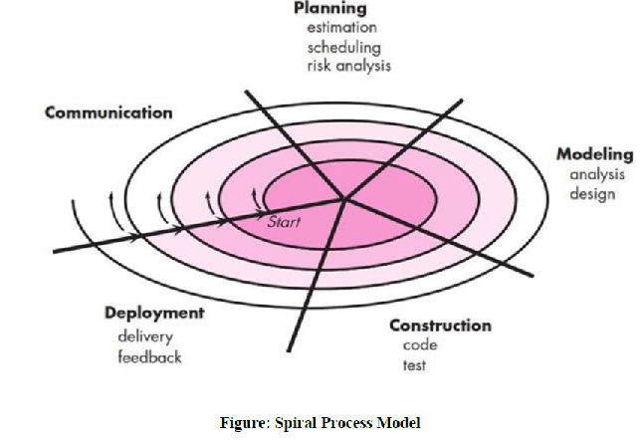
Dept of CSE

Slide 105
Communication. Before any technical work can commence, it is critically important to communicate and collaborate with the customer (and others takeholders The intent is to understand stakeholders’ objectives for the project and to gather requirements that help define software features and functions.
Planning. Any complicated journey can be simplified if a map exists. A software project is a complicated journey, and the planning activity creates a “map” that helps guide the team as it makes the journey. The map—called a software project plan.
Dept of CSE

Slide 106
Modeling. Whether you’re a landscaper, a bridge builder, an aeronautical engineer, a carpenter, or an architect, you work with models every day. You create a “sketch” of the thing so that you’ll understand the big picture—what it will look like architecturally, how the constituent parts fit together, and many other characteristics. If required, you refine the sketch into greater and greater detail in an effort to better understand the problem and how you’re going to solve it. A software engineer does the same thing by creating models to better understand software requirements and the design that will achieve those requirements.
Dept of CSE

Slide 107
Construction. This activity combines code generation (either manual or automated) and the testing that is required to uncover errors in the code.
Deployment. The software is delivered to the customer who evaluates the delivered product and provides feedback based on the evaluation.
Dept of CSE

Slide 108
When to use Spiral Model?
  When deliverance is required to be frequent.
  When the project is large
  When requirements are unclear and complex
  When changes may require at any time
  Large and high budget projects
Dept of CSE

Slide 109
Advantages:
➢ High amount of risk analysis hence, avoidance of Risk is enhanced.
➢ Good for large and mission-critical projects.
➢ Strong approval and documentation control.
➢ Additional Functionality can be added at a later date.
➢ Software is produced early in the software life cycle.
Disadvantages:
➢ Can be a costly model to use.
➢ Risk analysis requires highly specific expertise.
➢ Project’s success is highly dependent on the risk analysis phase.
➢ Doesn’t work well for smaller projects.
Dept of CSE

Slide 110
AGILE PROCESS
In earlier days Iterative Waterfall model was very popular to complete a project.
But nowadays developers face various problems while using it to develop software.
The main difficulties included handling customer change requests during project development and the high cost and time required to incorporate these changes.
To overcome these drawbacks of the Iterative Waterfall model, in the mid-1990s the Agile Software Development model was proposed.
Agile means “able to move quickly and easily.”
Dept of CSE

Slide 111
Any agile software process is characterized in a manner that addresses a number of key assumptions about the majority of software projects:
1. It is difficult to predict in advance which software requirements will not change and which will change. It is equally difficult to predict how customer priorities will change as the project proceeds.
2. For many types of software, design and construction are interleaved. That is, both activities should be performed in together so that design models are proven as they are created. It is difficult to predict how much design is necessary before construction is used to prove the design.
3. Analysis, design, construction, and testing are not as predictable (from a planning point of view) as we might like.
Dept of CSE

Slide 112
Given these three assumptions, an important question rises: How do we create a process that can manage unpredictability? The answer, as I have already noted, lies in process adaptability (to rapidly changing project and technical conditions). An agile process, therefore, must be adaptable.
Therefore, an agile software process must adapt incrementally.
To accomplish incremental adaptation, an agile team requires customer feedback (so that the appropriate adaptations can be made).
Dept of CSE

Slide 113
An effective catalyst for customer feedback is an operational prototype or a portion of an operational system. Hence, an incremental development strategy should be instituted.
Software increments (executable prototypes or portions of an operational system) must be delivered in short time periods so that adaptation keeps pace with change (unpredictability).
This iterative approach enables the customer to evaluate the software increment regularly, provide necessary feedback to the software team, and influence the process adaptations that are made to accommodate the feedback.
Dept of CSE

Slide 114
Agile SDLC model is a combination of iterative and incremental process models with focus on process adaptability and customer satisfaction by rapid delivery of working software product.
Agile Methods break the product into small incremental builds.
Every iteration involves across functional teams working simultaneously on various areas like planning, requirements analysis, design, coding, unit testing, and acceptance testing.
The division of the entire project into smaller parts helps to minimize the project risk and to reduce the overall project delivery time requirements.
Each iteration involves a team working through a full software development life cycle including planning, requirements analysis, design, coding, and testing before a working product is demonstrated to the client.
Dept of CSE

Slide 115
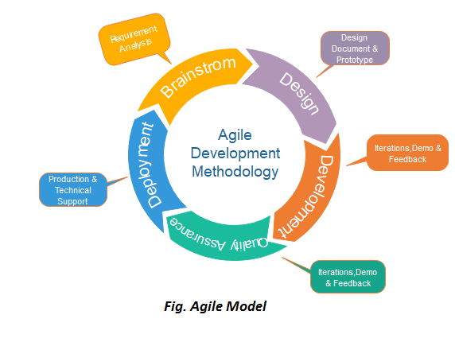
Dept of CSE

Slide 116
Phases of Agile Model:
Requirements gathering
Design the requirements
Construction/ iteration
Testing/ Quality assurance
Deployment
Feedback
Dept of CSE

Slide 117
1. Requirements gathering: In this phase, you must define the requirements. You should explain business opportunities and plan the time and effort needed to build the project. Based on this information, you can evaluate technical and economic feasibility.
2. Design the requirements: When you have identified the project, work with stakeholders to define requirements. You can use the user flow diagram or the high-level UML diagram to show the work of new features and show how it will apply to your existing system.
3. Construction/ iteration: When the team defines the requirements, the work begins. Designers and developers start working on their project, which aims to deploy a working product. The product will undergo various stages of improvement, so it includes simple, minimal functionality.
Dept of CSE

Slide 118
4. Testing: In this phase, the Quality Assurance team examines the product's performance and looks for the bug.
5. Deployment: In this phase, the team issues a product for the user's work environment.
6. Feedback: After releasing the product, the last step is feedback. In this, the team receives feedback about the product and works through the feedback.
Dept of CSE

Slide 119
When to use the Agile Model?
When frequent changes are required.
When a highly qualified and experienced team is available.
When a customer is ready to have a meeting with a software team all the time.
When project size is small.
Dept of CSE

Slide 120
Advantages:
❖ Customer satisfaction by rapid, continuous delivery of useful software.
❖ Customers, developers and testers constantly interact with each other.
❖ Close, daily cooperation between business people and developers.
❖ Continuous attention to technical excellence and good design.
❖ Regular adaptation to changing circumstances.
❖ Even late changes in requirements are welcomed
Dept of CSE

Slide 121
Disadvantages:
❖ In case of some software, it is difficult to assess the effort required at the beginning of the software development life cycle.
❖ There is lack of emphasis on necessary designing and documentation.
❖ The project can easily get taken off track if the customer representative is not clear what final outcome that they want.
❖ Only senior programmers are capable of taking the kind of decisions required during the development process.
Dept of CSE

Slide 122
Types of Software Process Models:
➢ Waterfall model
➢ Iterative model
➢ Incremental process models
  i. The incremental model
  ii. The RAD model
➢ Evolutionary process models
  i. Prototype model
  ii. Spiral model
➢ Unified process model
➢ Agile model
Dept of CSE

